Slide 1
A primer on Audit
Radu Popescu

Slide 2
Learning points and summary
What is audit?
Place of audit in an organization
Language: controls, design adequacy and effectiveness operations
How audit argues, and how you argue back
Real life events: an example
The way audit looks at events
Processes vs controls
Types of controls
Design vs effectiveness
Op. Risk vs Audit
What is an audit, the main parts
Audit issues
Common (bad) arguments in audit

Slide 3
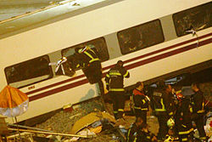
Train crash
The Santiago de Compostela derailment occurred on 24 July 2013, when an Alvia high-speed train travelling from Madrid to Ferrol, in the north-west of Spain, derailed at high speed on a bend about 4 kilometres outside of the railway station at Santiago de Compostela. Out of 222 people (218 passengers and 4 crew) on board, around 140 were injured and 79 died.
The train's data recorder showed that it was travelling at about twice the proposed speed limit of 80 kilometres per hour when it entered a bend in the rail. The crash was recorded on a track-side camera which shows all thirteen train cars derailing and four overturning. On 28 July 2013, the train's driver Francisco José Garzón Amo was charged with 79 counts of homicide by professional recklessness and an undetermined number of counts of causing injury by professional recklessness.

Slide 4
Train crash : what questions come to your mind?
What is first time that this person drove so fast?
What happened before? Was he reprimanded in any way? Why was he still driving?
Why was he speeding? Was he late? Was there pressure to make up to lost time?
Was he drunk? Is he the only drunk driver?
Was he the only one that broke the speed limit (in the last year)? Is this information available?
Are there any speed limits on the track? ( not recommendations)
Was this speed limit adequate? How often someone looked at it (last review)?
How much money was invested in safety? Are there any international norms? EU regulations?
What about signal? Do they turn red? Did they function?
Is it possible to have automatic breaks?
Why not? Too costly?
If yes, why did they not achieved the desired outcome? How often are those tested?
If this was a one off, how do we know that another one is not about to happen?
Etc etc.
As one can see, very little is about the train driver and very little about these questions are in public domain.

Slide 5
Train crash : the 'audit pov'
Speeding and going off track is a key risk of train travelling.
Controls must be in place: speed limits,
Automatic controls are preferred to manual ones.
One the accident has happened, the focus is not on the accident, but on the controls.
Have these controlled been adequately designed?
Did they function?
How often they are checked to function?
What happened when a problem has been found?

Slide 6
At a glance
What is audit?
The three lines of defence
Audit purpose
Controls vs processes
Examples
Audit as a project management exercise

Slide 7
Processes and controls
Everything is a process:
usually refers to an activity that has a beginning, an end, a purpose, an owner, etc.
Controls: special type of processes, they mitigate a risk
Two types: Detective and Preventative
Policies are not controls.

Slide 8
Controls
Preventative: they happen before the risk can materialise
Approvals (e.g. trade approval, model validation)
Detective: limit breaches report, data quality
Language of controls (in UBS):
KPC (key procedural control), KPCi (KPC instance)
(more in the issue description below)

Slide 9
Three lines of defence
First line: where business is done (and risk is taken)
Second line: where risk is controlled
Third line: Internal Audit (or independent audit), it is independent of the business and controls and report directly to the board
There are also Fourth line or Fifth line… see BCBS paper…

Slide 10
Audit
Mission: Provide assurance that key risks are controlled, that the controls are well designed and that they function effectively.
websites: IIA, FED, etc.
Internal auditing is an independent, objective assurance and consulting activity designed to add value and improve an organization's operations. It helps an organization accomplish its objectives by bringing a systematic, disciplined approach to evaluate and improve the effectiveness of risk management, control, and governance processes.
Model's audit: audit of model controls
Now mentioned in regulations: SR 11-7, SS 3/18, TRIM
SS 3/18: P2.4 Role of Internal Audit (IA): IA should assess the overall effectiveness of the model risk management framework. IA should evaluate and independently verify whether model risk management practices are comprehensive, rigorous, and effective.

Slide 11
Audit structure
Planning
Control designed assessment
Testing
Reporting
All this takes around a couple of months, but in theory if something important is discovered, this can be extended.

Slide 12
Planning
Key risks are identified, alongside with key controls.
Scope is agreed. (Key areas of focus, UBS language)
Missing controls are identified (issues are raised).
Risks and controls list is completed.
What information is gathered:
- who are the contact people
- know issues
- reports about the business that is audited
- external audit reports etc.
In UBS: Kick-off meeting, a good opportunity to say all bad things you already know about, and ask if you need to self-raise an issue.

Slide 13
Control design assessment
Controls are taken one by one and evaluated.
Usually this involves a walk-through or a test of one.
This is when the process is completely described, and the controls associated spelled out.
Conclusion: adequately designed (i.e. if it works well, it will do the job) or not (issue)
Issues on the designed:
- not the right frequency
- not the right level of seniority for approval
- not enough skills, budget, etc.
- it can be bypassed
- does not trigger anything (for detective controls)
- does not stop all bad things happening (for preventative controls),
- no consequences ('so what' question)
- evidence of execution is not retained (audit trail)
- does not systematically control the risk
Common sense plays a role in evaluating the control.

Slide 14
Testing
For each control:
a sample of instances of the operating control is chosen.
each instance of the control is checked to see it performed as it was designed.
Manual controls vs automatic.
Standards about sampling are an important thing for auditors (be aware).
Information is gathered and recorded.
Testing conclusion: the control is effective or not (cf. the design is adequate or not)

Slide 15
MRMC Controls (from SORT)
Model Validation, B-179824
N22091 MRMC-Risk Finance & Client Risk Models

Slide 16
MRMC Controls (from SORT)
Maintenance and Attestation of Model Inventory Records (2nd LoD) B-181165
N22091 MRMC-Risk Finance & Client Risk Models

Slide 17
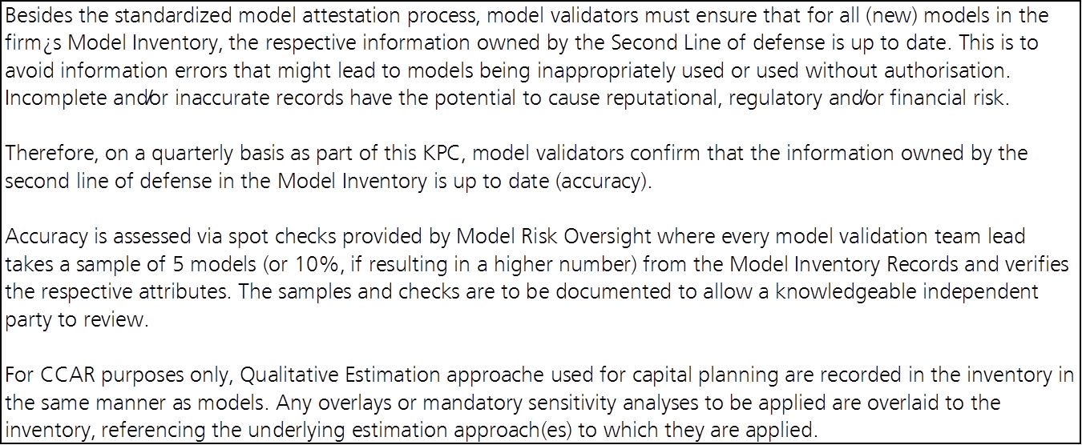
MRMC Controls (from SORT)
On-boarding of the new GoM Policy Framework (2nd LoD) B-181184
N22091 MRMC-Risk Finance & Client Risk Models

Slide 18
How audit argues
A general structure of an audit issue is:
There is a risk
What is the cause (blame is generally to be avoided)
Something needs to be done (to mitigate the risk)
The control owner is expected to propose an action plan and sometimes a risk acceptance until the solution is up and running
On balance things will be better
(this is a general argument scheme for policy claims)
Usually there are two steps: factual accuracy and issue discussion.
One can disagree with factual accuracy, with the risk statement, root cause, with the control statement or with the need to do something. A rule of thumb is to chose what to disagree with and not shift from one point to another and back.

Slide 19
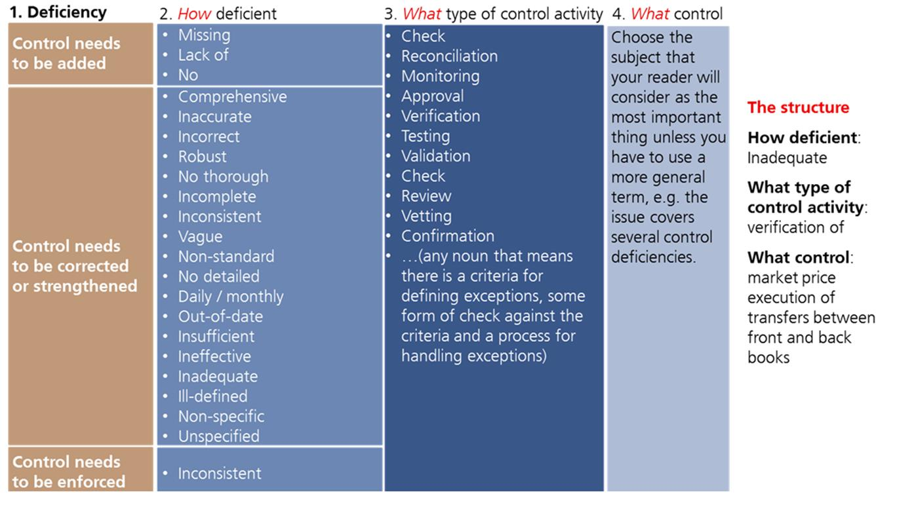
What to expect in UBS

Slide 20
Rubbish arguments w. audit
Safety in numbers: we know that this is a problem, but nobody does anything about it. A variant of this is 'we are best in class'.
Why now: this has been looked at before and not been identified, why now?
Real vs imaginary, usually goes like: 'we know this has not been approved, but the real approval happened when it was released in production'
(this is a dissociation argument, rather rare in real life)
Slippery slope: if we do this, than we have to do it for this too, and this, and where do we stop? (this could also be valid)
Everyone knows about it so there is no need for evidence.
We would like to do it but there is no funding (root cause needs to be clarified).
You do not understand anything, we do this every day.

Slide 21
Advice from personal experience
A. See if the issue can be solved before the audit closes. This will save a lot of time and pain later.
For this: engage with audit on their findings as soon as possible (not the current policy).
B. Make up your mind if there is an issue, accept or try to change it. You do not necessarily need to push back.
C. Try to provide evidence for closure if closure is possible. Much more documentation will be required in general later, time will be lost explaining maybe to someone who is unfamiliar with the issue 6 months down the road.
D. IA issues are easier to deal with than FED/OCC

Slide 22
What was all about
Train crash
Risks and controls
Audit as the third line
Jargon: control design vs operating effectiveness
Audit issues: risk/root cause/control statement (missing, design, operating)/action plans
What has not been covered: Op Risk

